Slide 1
03-01. Python programming for data science
Youngsoo Kim <pineland@hanmail.net>
Code : https://github.com/pineland/AIDA/

Slide 2
Contents
Python introduction
Numpy
Pandas
Matplotlib
Seaborn
SciPy
Scikit-learn
Jupyter Notebook

Slide 3


“Python is an experiment in how much freedom program-mers need. Too much freedom and nobody can read another's code; too little and expressive-ness is endangered.”
- Guido van Rossum

Slide 4
Characteristics of Python
Open source general-purpose language
Platform-independent interpreter language
Do not create its executable file.
Object Oriented, Procedural, Functional
Dynamic typing language
Determine types of variables at run time.
Memory auto management
Easy to interface with C/C++/Java/Fortran
http://docs.python.org/

Slide 5
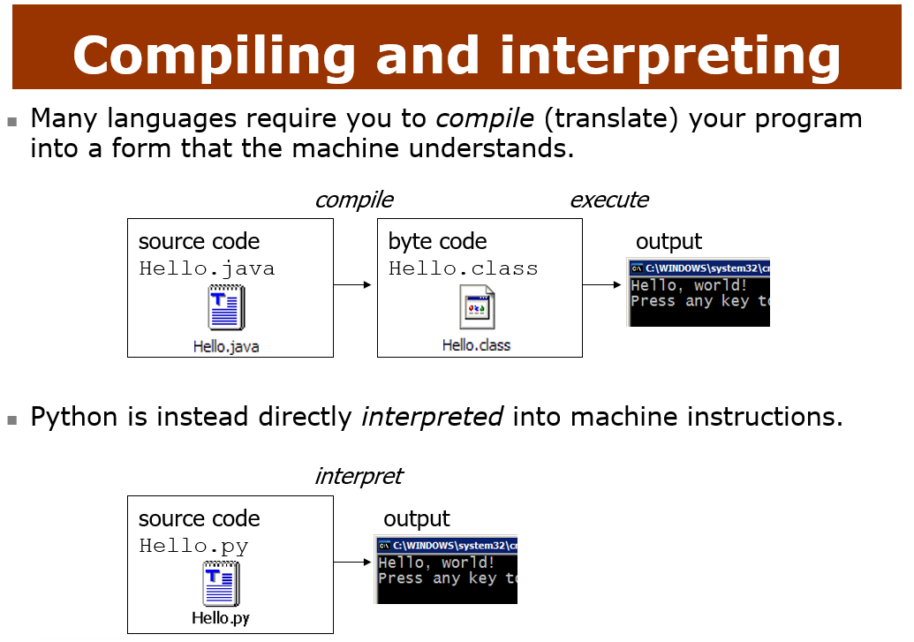

Slide 6
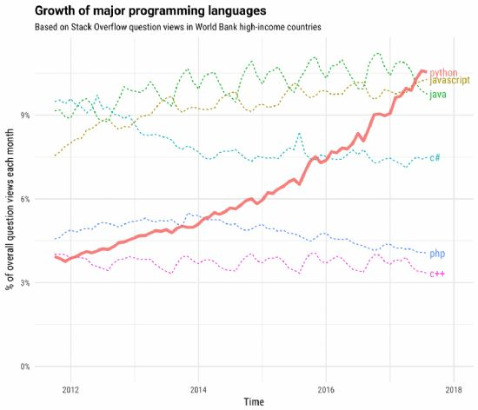
Why python for data science?
Easy and simple programming language
Diverse and rich libraries for data science
Scikit-learn, TensorFlow, Pytorch
Large developer community
* src : ZDNet Korea (2017. 9월호) ☞

Slide 7
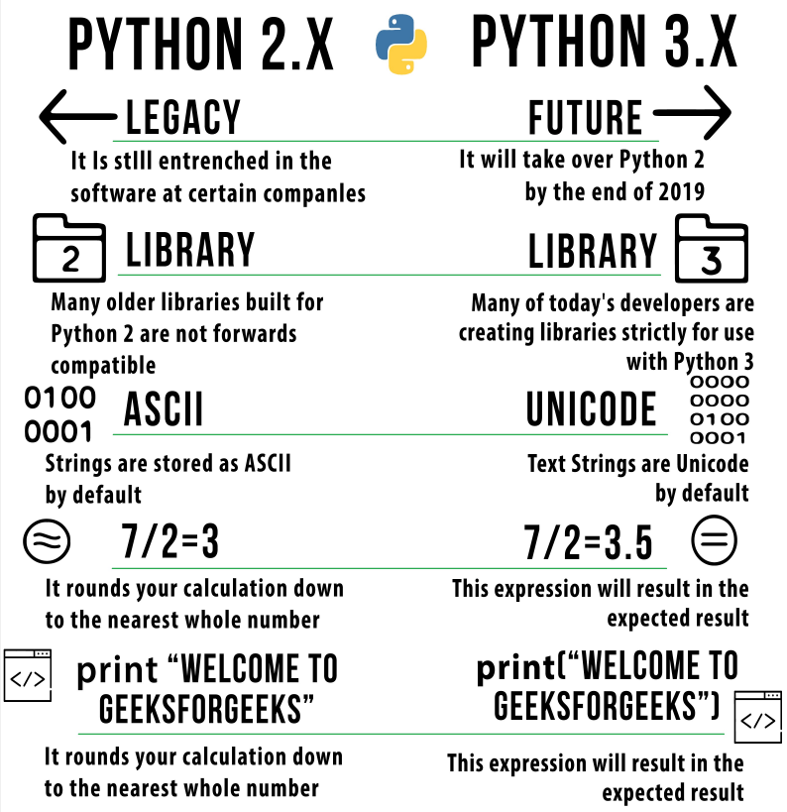

Slide 8
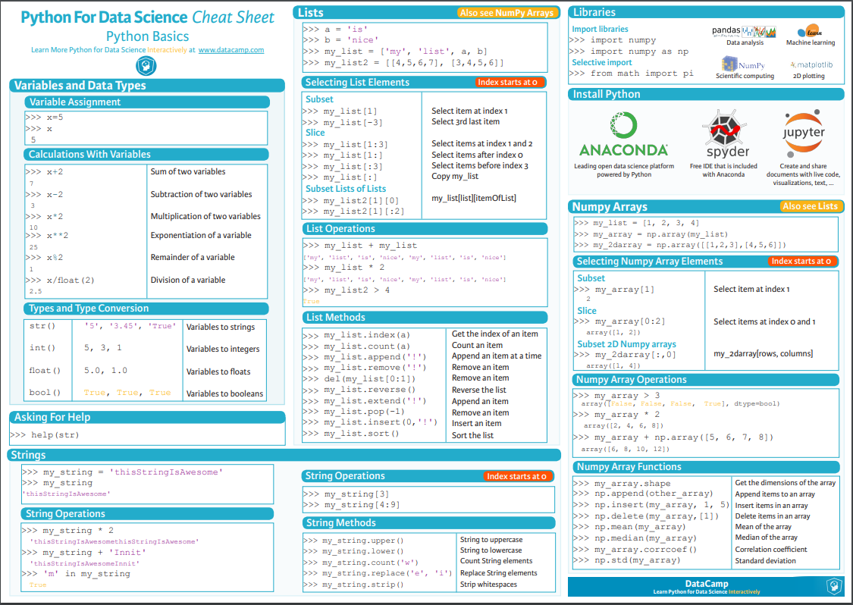
https://s3.amazonaws.com/assets.datacamp.com/blog_assets/PythonForDataScience.pdf

Slide 9
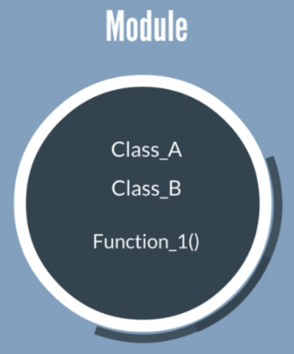
Importing Modules
Python module
A file containing python definitions,
functions, classes and statements
with extension .py.
Python 3.x supports over 200 modules
string, date, time, decimal, random, file, os, sys, xml, email, http, ftp, etc.
Why modules ?
Reusability of code.
Allow complex programs to be structured well according to function.
Can separate and manage code by name spaces.

Slide 10
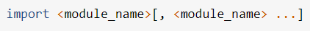
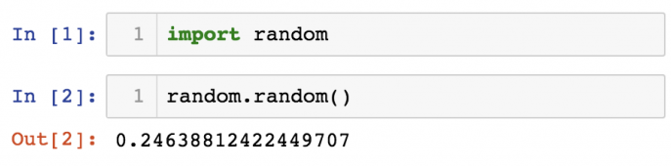
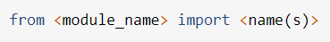
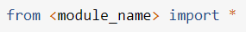
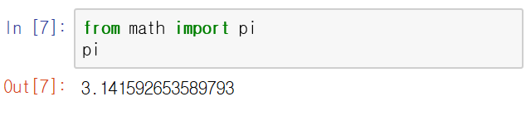
How to import a module ?
Generally
In case that all the functions and classes provided in the module are not needed

Slide 11
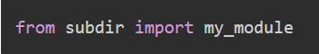
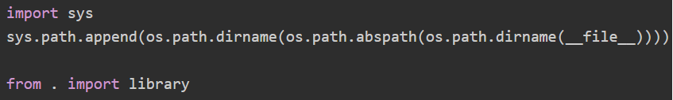
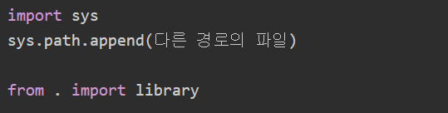
In case that the required module exists in a different directory (package).
import a module in the subdirectory
import a module in the upper directory
import a module in the different directory

Slide 12
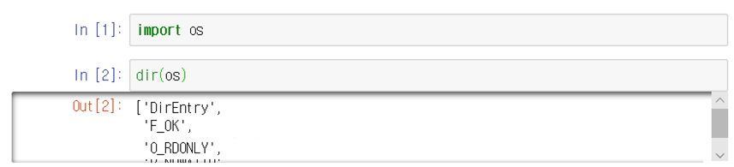
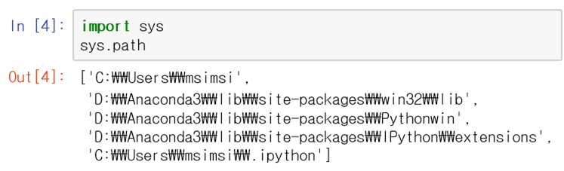
How to find functions of a module ?
Path to the module
Sequence of searching path
① Directory in which the program runs
② Directory registered with the PYTHONPATH environment
③ Standard Library Directory
Notes:
모듈 경로

Slide 13


Slide 14

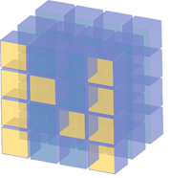
Fundamental package for scientific computing with Python.
Provides a N-dimensional structured array for rapid numerical calculation
Continuous memory allocation, Vectorization
Useful linear algebra, Fourier transform, and random number capabilities
Basis for other Python utilities (e.g. pandas).
Docs : https://numpy.org

Slide 15
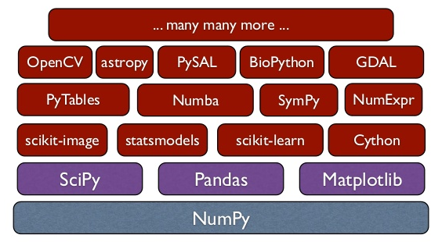
Numpy stack

Slide 16
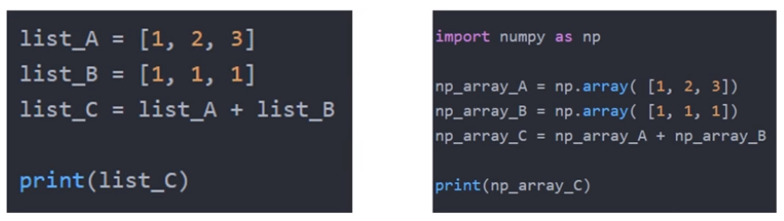


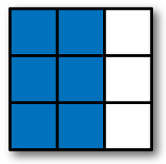

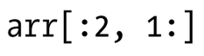
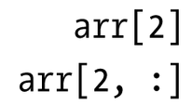
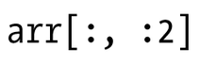
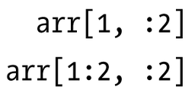
Supports row, column, and matrix computations.
출력결과는 ?
※ 데이터 접근 방법

Slide 17
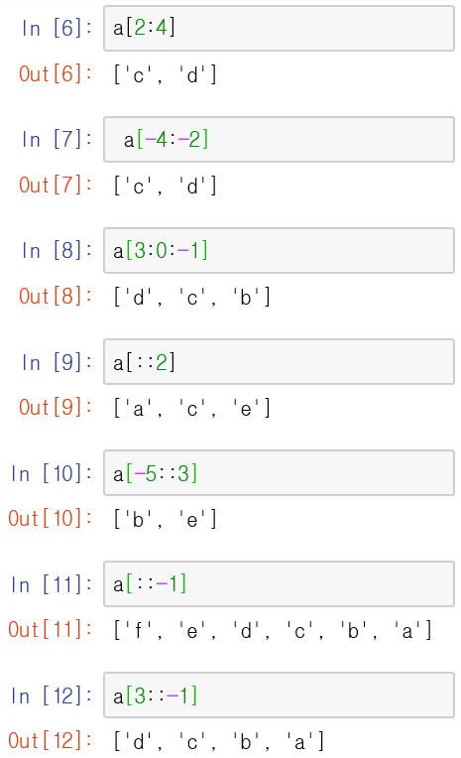
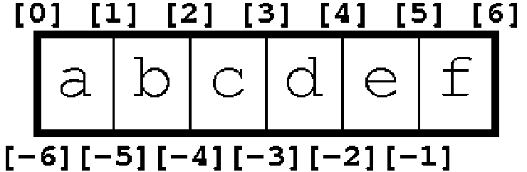
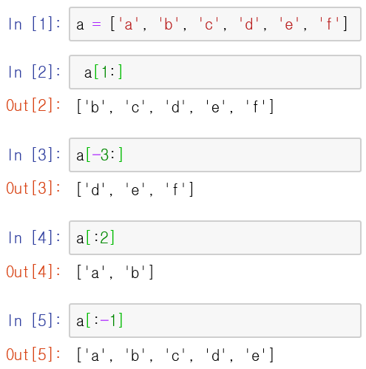
Slicing -1D

Slide 18
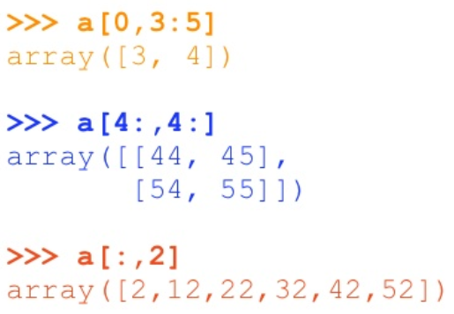
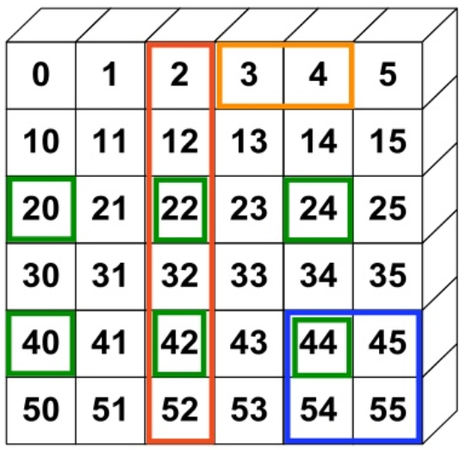
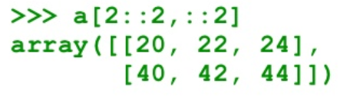
Slicing -2D

Slide 19
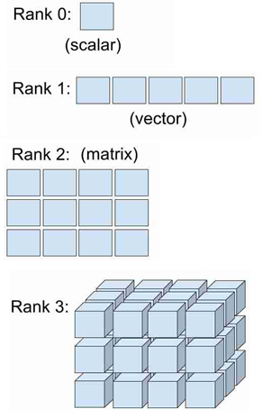
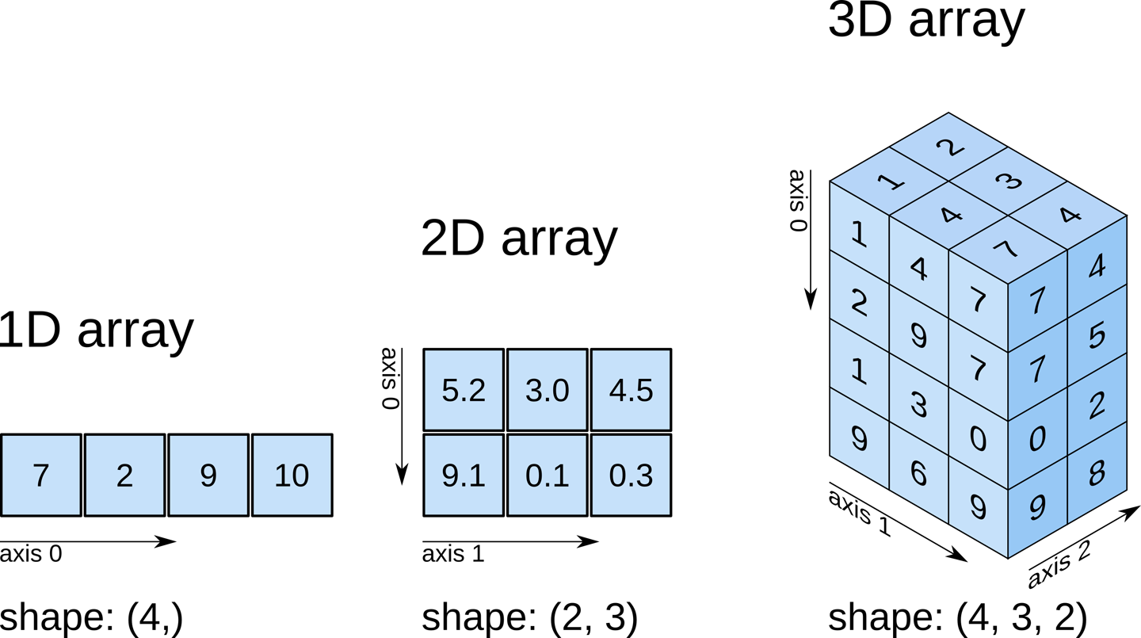
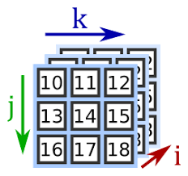
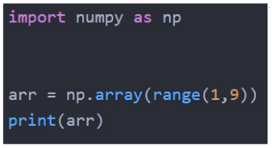
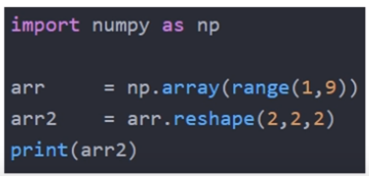
Shape, Rank, Axis
3D array
shape(i, j, k)
※ 표현방법 : shape(axis 0, axis 1, axis 2 [,…])
* Rank = ndim = # of axes
출력결과는 ?

Slide 20
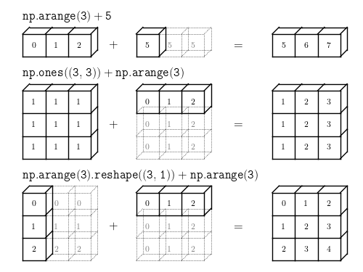
Broadcasting
occurs between arrays of different shapes.

Slide 21
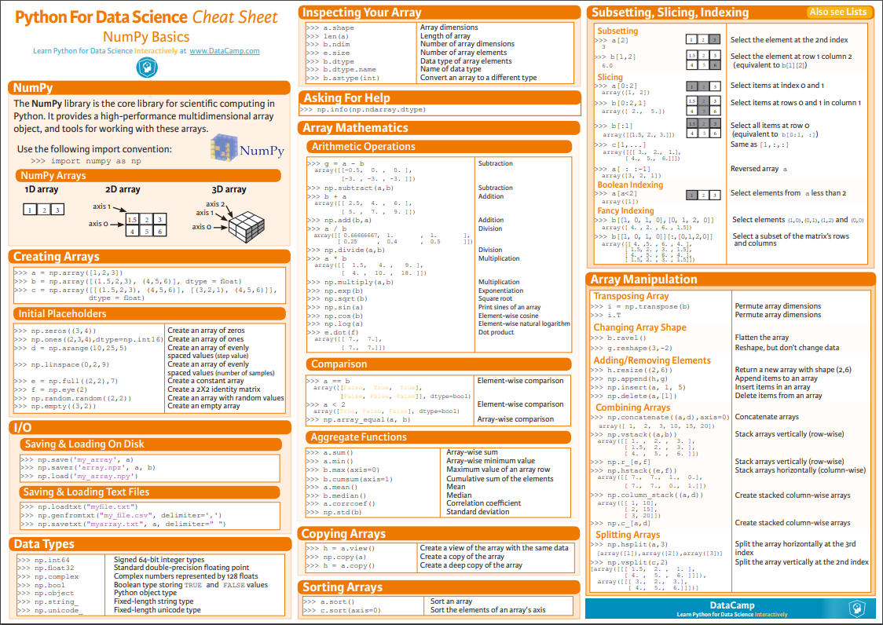
https://s3.amazonaws.com/assets.datacamp.com/blog_assets/Numpy_Python_Cheat_Sheet.pdf

Slide 22


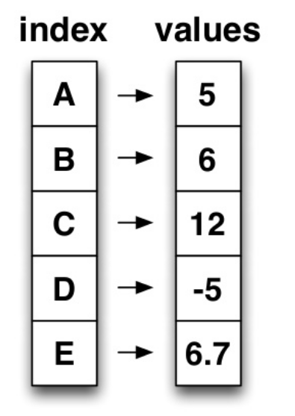
Rich relational data tool built on top of NumPy
Easily manipulates data in matrix units in Python.
Can be accessible by column or row
Easy to use, excellent performance
Docs : https://pandas.pydata.org/pandas-docs/stable/
Two basic data format
Series : vector format
Subclass of numpy.ndarray
pd.칼럼.values = numpy 구조
The index name can be assigned
as you want.
Data : any type
※ 데이터 접근방법 ☞
eg) tab[‘A’] ==> 5

Slide 23
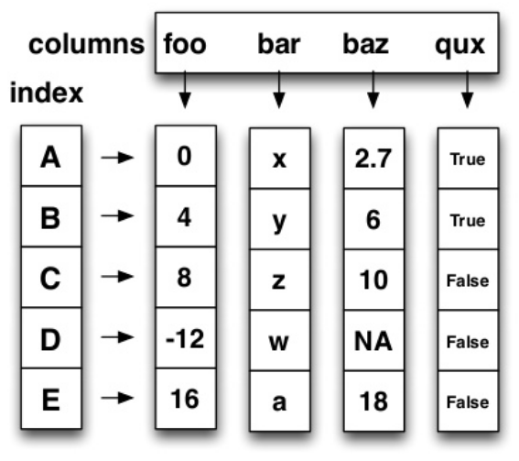
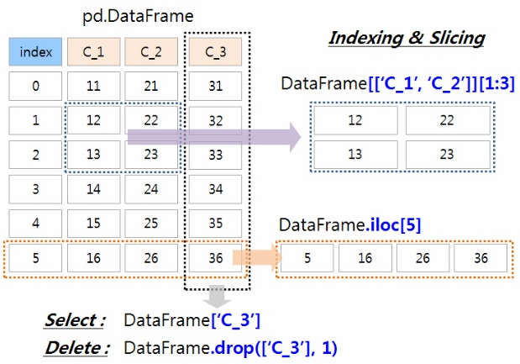
Data frame : matrix format
numpy array-like
row and column index
each column can have
a different type
columns can be inserted or
deleted
※ 데이터 접근
방법 ☞

Slide 24
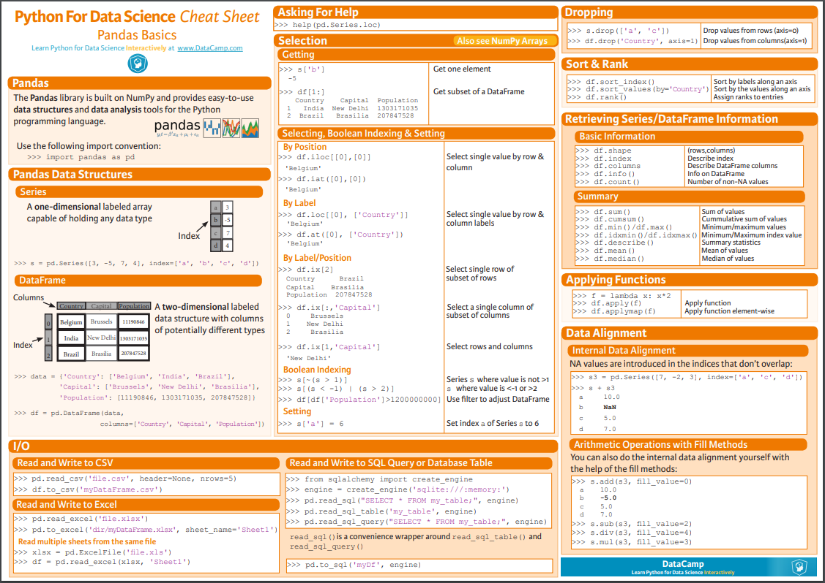
https://assets.datacamp.com/blog_assets/PandasPythonForDataScience.pdf

Slide 25
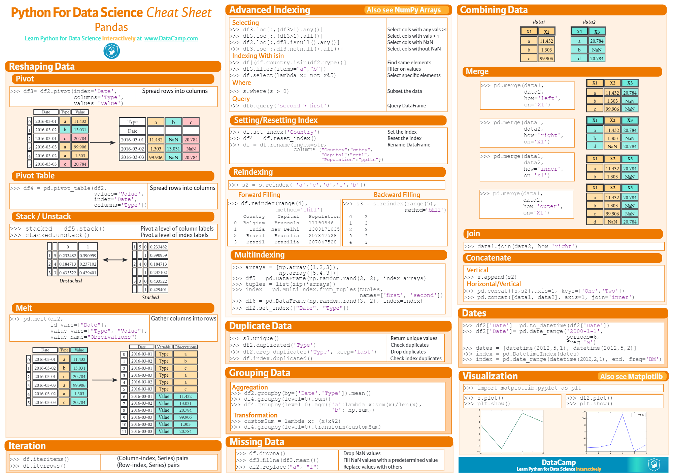
https://github.com/FavioVazquez/ds-cheatsheets/blob/master/Python/Datacamp/pandas.pdf

Slide 26

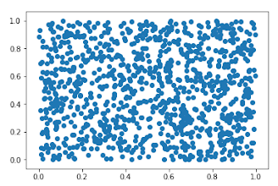
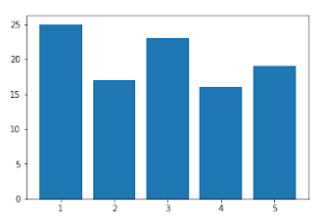
Most commonly used data visualization library package in Python
Docs : https://matplotlib.org/
Types
Scatter - bar chart
>> plt.scatter(x, y)
>> plt.bar(x, hight, width,
align='center')
Notes:
• Python Graph Visualization 으로 가장 많이 사용되는 라이브러리.
• Python Visualization 에 많은 공헌을 함.
• 그러나 직관적이지 못한 API 로 인해 개발에 익숙해 지는데 많은 시간 필요하며 현대적인 감각이 떨어지는 Visual 개선 필요.

Slide 27
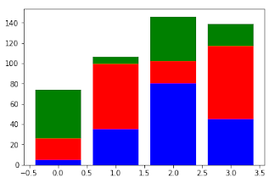
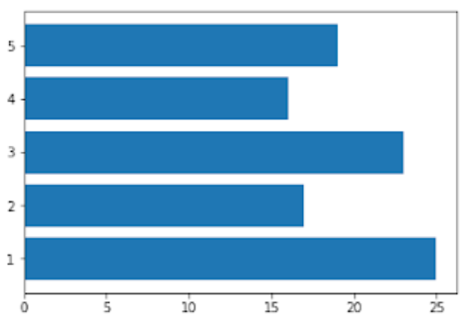
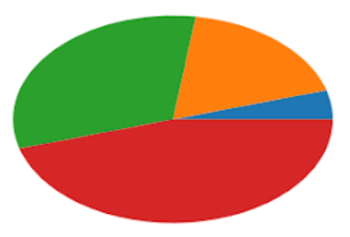
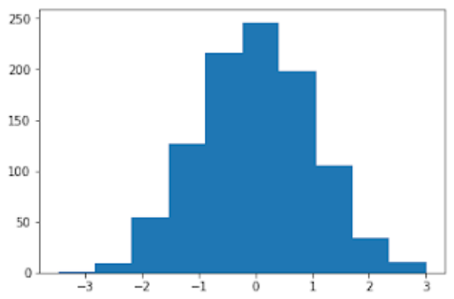
stack bar chart - horizontal bargraph
pie chart - histogram
>> plt.bar(x, a, color='b') >> plt.bar(x, b, color='r', bottom=a) >> plt.bar(x, c, color='g', bottom=a+b)
>> plt.barh(x, height)
>> plt.pie(x)
>> plt.hist(X, bins=10)

Slide 28
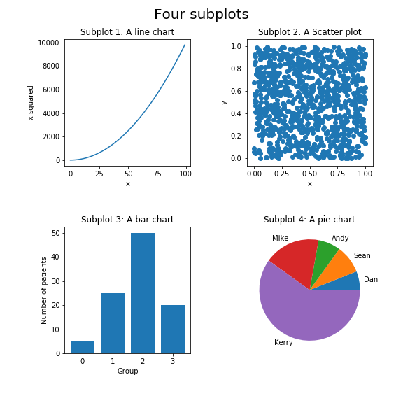
multi-graph
# Create subplot 1
plt.subplot(221)
plt.plot(x1,y1)
plt.set_xlabel('x')
plt.set_ylabel('x squared')
plt.set_title('Subplot 1: A line chart')
# Create subplot 2
plt.subplot(222)
plt.scatter(x2,y2)
plt.set_xlabel('x')
plt.set_ylabel('y')
plt.set_title('Subplot 2: A Scatter plot')
# Create subplot 3
plt.subplot(223)
plt.bar(range(x3,y3)
plt.set_xlabel('Group')
plt.set_ylabel('Number of patients')
plt.set_title('Subplot 3: A bar chart')
# Create subplot 4
plt.subplot(224)
plt.pie(x4, labels=labels)
ax4.set_title ("Subplot 4: A pie chart")
<- 2행 2열 그래프의
3번째!

Slide 29
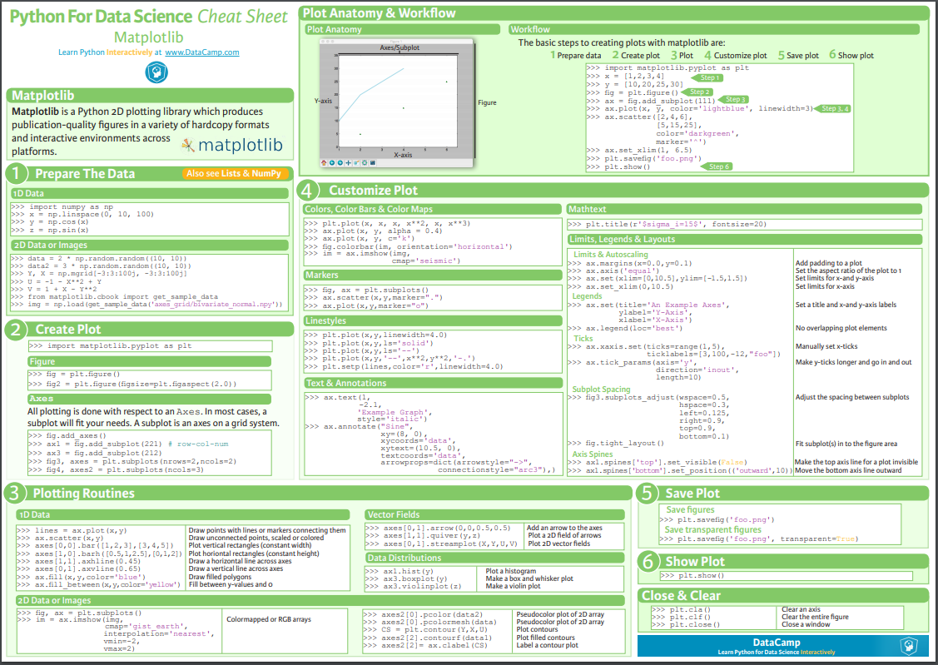
https://s3.amazonaws.com/assets.datacamp.com/blog_assets/Python_Matplotlib_Cheat_Sheet.pdf

Slide 30
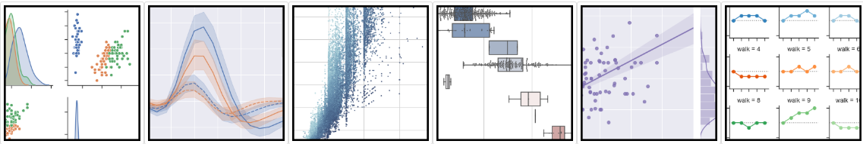
Seaborn
a Python data visualization library based on matplotlib.
Provides a high-level interface for drawing attractive and informative statistical graphics.
Easily interface with Pandas
Docs : https://seaborn.pydata.org/

Slide 31

https://s3.amazonaws.com/assets.datacamp.com/blog_assets/Python_Seaborn_Cheat_Sheet.pdf

Slide 32

A library of packages with functions such as signal processing, optimization, statistics, etc.
provides many user-friendly and efficient numerical routines such as routines for numerical integration, interpolation, optimization, linear algebra and statistics.
Run on the NumPy.
basically uses Ndarray of NumPy as the default data type.
Docs : https://www.scipy.org/

Slide 33

https://s3.amazonaws.com/assets.datacamp.com/blog_assets/Python_SciPy_Cheat_Sheet_Linear_Algebra.pdf

Slide 34

Scikit-learn (1)
The easiest and most efficient development library for Python-based machine learning.
Provides a wide variety of APIs for machine learning.
Simple and efficient tools for data mining and data analysis
Accessible to everybody, and reusable in various contents
Built on Numpy, SciPy, and matplotlib
Open source, commercially usable-BSD license
Docs : https://scikit-learn.org/stable/index.html

Slide 35

Scikit-learn (2)
Main packages

Slide 36
Scikit-learn (3)
Typical program structure
load a model and define(set up hyper-parameters}
train the model (fit)
predict or predict_proba or transform
measure accuracy (scoring)
from sklearn.neighbors import KNeighborsClassifier
model = KNeighborsClassifier(n_neighbors=3)
model.fit(x_train, y_train)
y_predict = model.predict(x_test)
accuracy_score(y_test, x_test)

Slide 37

https://s3.amazonaws.com/assets.datacamp.com/blog_assets/Scikit_Learn_Cheat_Sheet_Python.pdf

Slide 38

https://github.com/FavioVazquez/ds-cheatsheets

Slide 39

Q & A

